Slide 1
Using Faculty180 Activity Reporting
Introductory User Guide for Entering Faculty Professional Activities

Slide 2
What Is Faculty180?
System for faculty to input activities such as these:
Teaching
Research
Service
Professional Development
Memberships
Work Experience
Honors and Awards
System to generate reports such as these:
Annual report (individual)
Annual report (unit)
Activity aggregations
Online profile pages

Slide 3
Sources of Information
Manual User entry
Manual entry for many sections
Import publications list from external sources such as EndNote
Banner (contact details, courses taught)
eTRACS/RAMSeS (grants and contracts)
Elentra and XComP Events
Starting in Summer 2022 Brody Elentra and SODM XComP events will be entered in the Teaching Category via automated feed
Sedona (migrated data from legacy system)

Slide 4
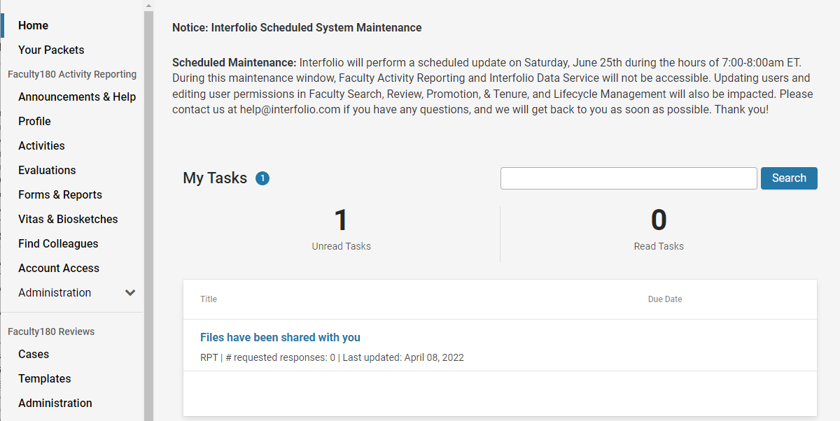
What Does Faculty180 Look Like?
The Home Page Dashboard will indicate actions needed and link to sections for you to complete.
Profile includes contact details, degrees, and experience
Activities sections are for teaching, research, and service entries
Vitas and Biosketches will let you preview your annual report or generate a CV at any time

Slide 5
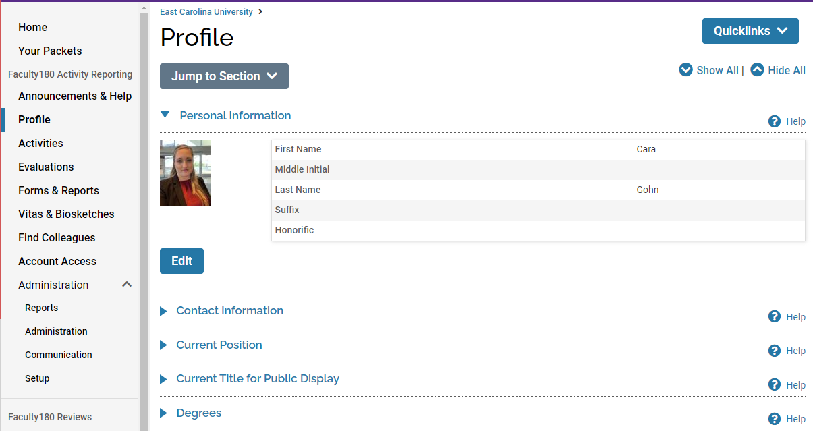
Profile
These name, contact, and current position information is imported from Banner and locked in Faculty180. Corrections must be updated in Banner or PiratePort.

Slide 6
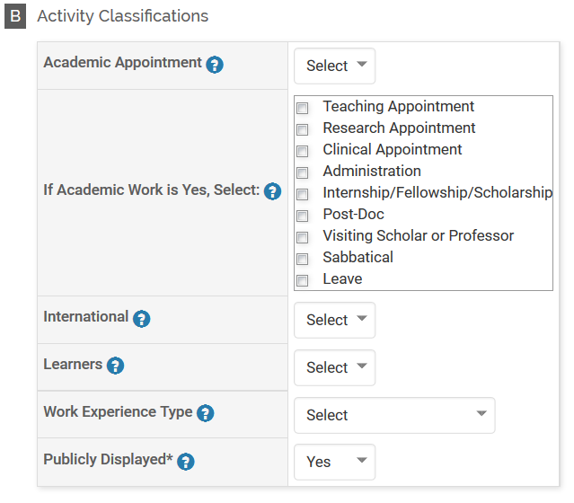
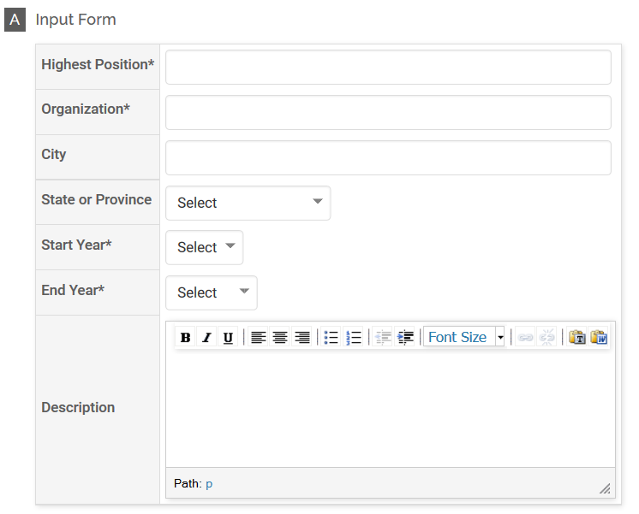
Profile: Work Experience
Part A - Input Form has fields to describe your entry
Part B - “Activity Classifications” to group entries.

Slide 7
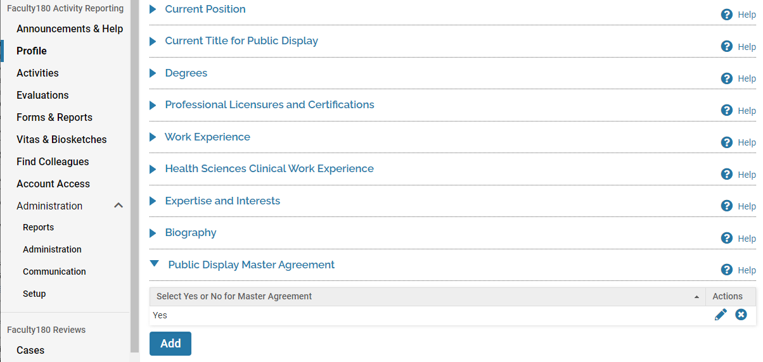
Profile: Public Display Master Agreement: Automatic Creation of Scholars@ecu.edu Profiles

Slide 8
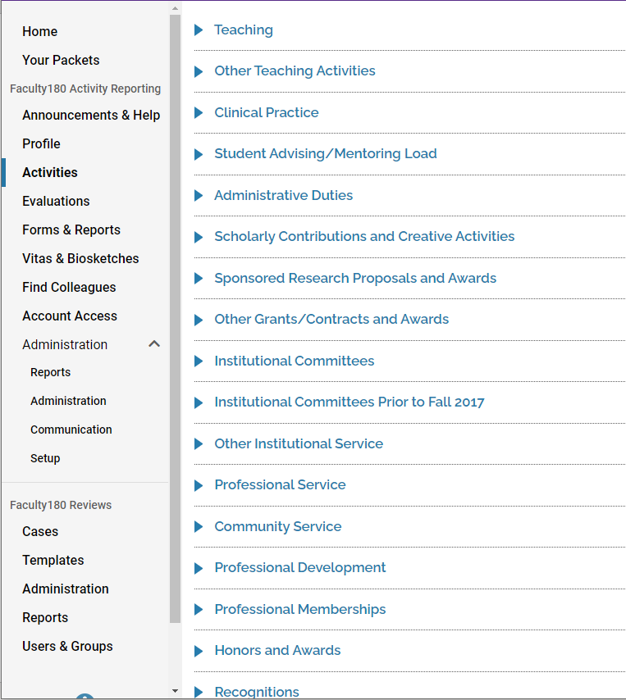
What Kinds of Activities Are Input?
Courses Taught, Other Teaching, Administrative and Clinical Practice
Grants, Publications, and Presentations
University, Professional, and Community Service

Slide 9
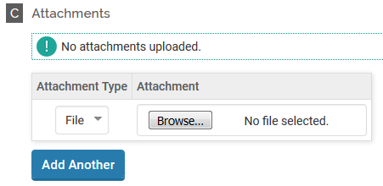
General Info on Entries:
Attachments: You can attach one or more files (limit 750MB/file) or a URL
Select the right “Save” option!
Save will save your progress and keep you in the same form
Save and Add Another will save your entry and open a new one of the same kind
Save and Go Back will save your entry and go back to the Activities form
Cancel will delete what you have typed and cancel your entry

Slide 10
Teaching: Uploaded from Banner*
*If a course you taught is not uploaded, enter in Other Teaching Activities.

Slide 11
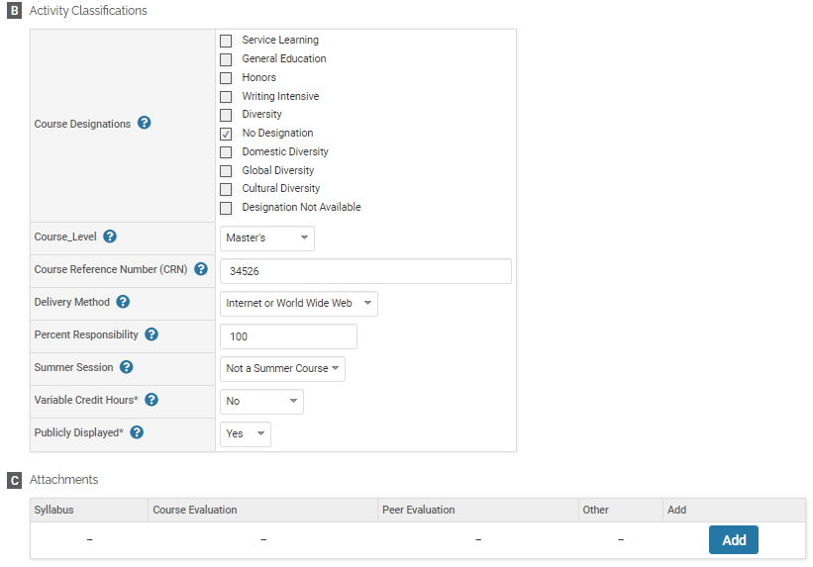
Teaching: Uploaded from Banner
Course data will be loaded to Faculty180 about a week after the last census day. You can upload attachments and view Classifications by clicking the edit pencil next to the course.
Edit Classifications and add attachments in sections B and C.

Slide 12
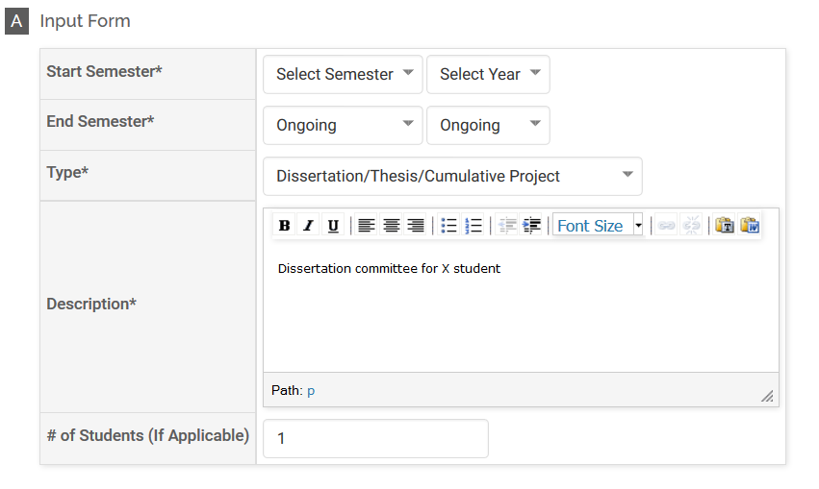
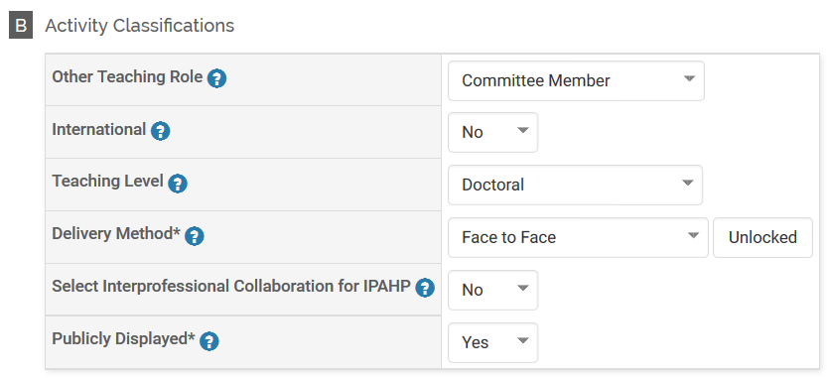
Other Teaching Activities
Other Teaching types include Assessment of Learning, Diss/Thesis/Cumulative Project, Course Creation/Delivery, Course Redesign, Study Abroad, Special Projects, and more. For entries, select your Type in conjunction with the Role in Activity Classifications.

Slide 13
Scholarly Contributions: Articles
For Manual Input:
Status (change as article goes through process)
Journal titles match against a central title list
Coauthor listing/classification
Review Type
Publication Type AND Article Type
Scholarly Type*
Notes:
Scholarly Type: Basic or Discovery Scholarship, Applied/Integrative Scholarship, Teaching & Learning Scholarship, Not Classified

Slide 14
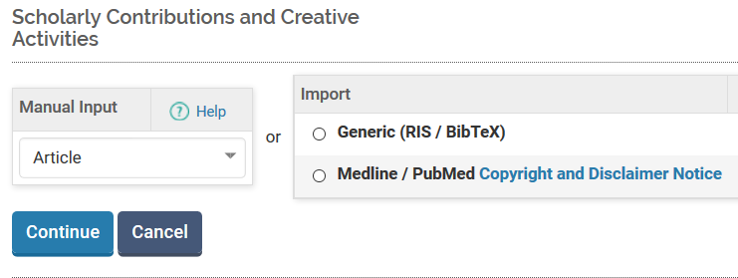
Scholarly Contributions: Articles (Importing Articles)

Slide 15
Scholarly Contributions: Articles (Importing Articles)
Tip: Scopus BibTex works pretty well

Slide 16
Video Clip to Demo Import

Slide 17
Connect with ORCiD
Navigate to Vitas & Biosketches
Go to Legacy Vitas
Scroll down to Vita / Profile Systems
Click Create or Connect your ORCID iD
Click Import and choose records to import to various activity and profile categories – funding, education, employment, etc.

Slide 18
University Committees
Select Committee name. If not in list:
Check with your Superuser about adding the committee to the list menu, or
Choose “Other” and type in the new committee name.
Change Unit for college/dept committees

Slide 19
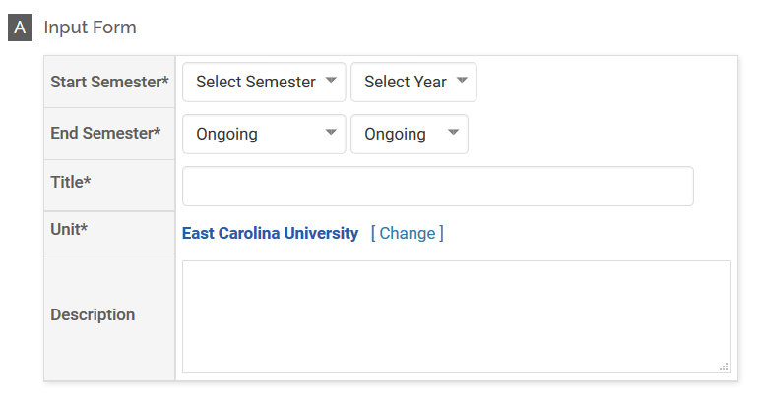
University Service (Other than Committees)

Slide 20
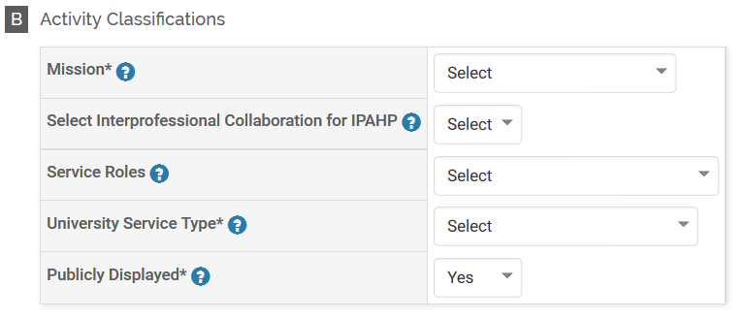
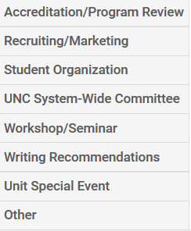
University Service (Other than Committees)
University Service Types

Slide 21
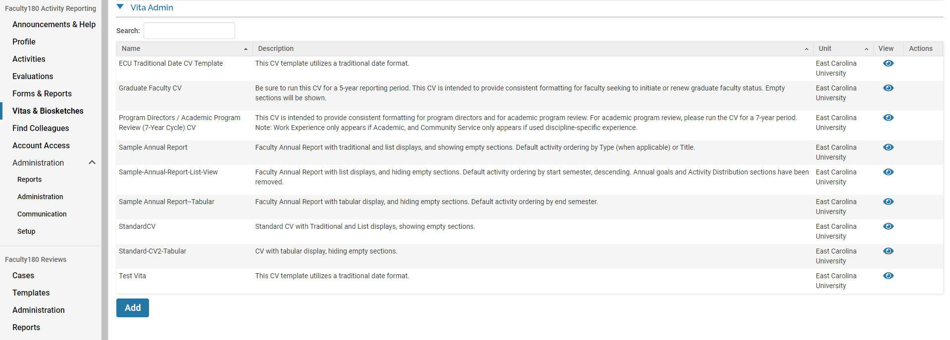
Create CV or Annual Report Note: Your College will have a unit specific template available to you.
Click the Eye, set time periods, and review. You can export to Word or PDF.

Slide 22
More Information / Questions?
https://faculty180.ecu.edu
Find Links to Training Materials, List of Super Users, Upcoming Training Sessions and Previously Recorded Training Sessions.
faculty180@ecu.edu (General questions)

